Slide 1


SHAHBAZ TARIQ
06-Aug-2024

Slide 2

Outline
Executive Summary
Introduction
Methodology
Results
Conclusion
Appendix

Slide 3
Executive Summary
The following set of slides present the methodology in a orderly fashion that includes the tactics adopted for data collection, data wrangling, data visualization, folium mapping, dashboard construction and algorithm development.
This slide presents the case as to why ‘KSC LC-39A’ is best performing launch Site, why booster versions FT and B4 of the F9 rockets should be used for payloads > 4500 Kgs and why KNN might be the best classification algorithm for predicting landing outcomes of any future launches.

Slide 4
Introduction
This project is focused on assessing past records of rocket launches for various missions by SpaceX to better understand the factors at play and help make informed decisions to improve landing outcomes for future missions.
The goal is to understand how different attributes of the rocket launches interact with one another from which we can develop various visualization tools, including an interactive dashboard, and a classification algorithm that can help predict the landing outcome of future missions. SpaceX can use these tools to better optimize their decisions that contribute to the improvement of landing outcomes.

Slide 5

Section 1

Slide 6
Methodology
Executive Summary
Data collection methodology: Data was first collected from the SpaceX API and wiki pages from which key attributes were extracted and processed to handle missing information, thereby making the entire dataset ready for use.
Data was wrangled in terms of identifying the key attributes, extracting them and storing them in lists through custom developed functions and then processed to handle any missing values, developing Booleans for categorizing, etc.
Attributes were then compared against each other using various plots to help visualize any patterns/trends that may be key to making appropriate decisions.
This was then further worked on to develop interactive visual analytics using Folium and Plotly Dash to maintain a dynamic ease of use when visualizing.
Lastly, 4 different classification models were constructed by first splitting the data set into training and test sets which were then used to train the model and predict accuracy scores along with a confusion matrix for each model.

Slide 7
Data Collection
GitHub Link: Here
Extract single values from lists in the table, making the data easier to handle
Use the core ID to get details like block number, reuse count, and serial number, then save them
START
Convert the date format and extract data before 13 Nov 2020
Connect to the SpaceX API to collect data on rocket launches
Combine all the collected data into a single organized table
Set up storage areas to collect additional details about each launch, like the rocket’s name, launch site, and payload mass
Change the data from the API into a table format that’s easier to work with
Keep only the data for the 'Falcon 9' rocket
Use the rocket ID to get the rocket’s name and save it
Perform data wrangling such as checking for and substituting any missing values
Clean the data:
Keep only the parts of the data that are useful, like flight numbers, dates, rocket details, etc.
Remove rows with multiple cores or payloads, focusing on simpler rocket launches
Use the launch site ID to get its name and geographical coordinates, then save them
ave the final organized data table as a file for future use
Use the payload ID to get its mass and orbit, then save them
END

Slide 8
Data Collection - Scraping
GitHub Link: Here
START
Set up a place to store the data you find, organized by the labels
Create functions to extract specific information from a webpage, like dates, booster versions, etc.
Go through the tables, and for each row that represents a launch, collect the data (like the launch date, payload, etc.)
Connect to the SpaceX wiki and extract data from it
Save the collected information in the organized storage area
Use a program to help read and understand the webpage
Take all the stored data and arrange it into a neat table
Look for the tables on the webpage that contain the launch data
Save the table as a file that can be easily accessed and used later (like an Excel sheet)
Identify the labels (like "Launch Site" or "Payload") that describe each piece of data in the tables
END

Slide 9
Data Wrangling
Start
Load SpaceX Dataset
Data processing procedure:
After loading in the SpaceX dataset, the percentage of missing values of each attribute was calculated along with their datatypes.
Next, the value counts of attributes such as Launch Site, Orbit, Outcome were extracted to determine the frequency of each record in the respective attribute.
The keys of the landing outcomes were extracted along with their indexes which was then used to create a set consisting of only the bad outcomes.
The Outcomes column in the SpaceX dataframe was then iterated over, using the bad outcomes set as a filter condition to append a list of good vs bad outcomes.
This list was then added to the dataframe as a Boolean value (categorical) to help showcase the outcome of each record (success or failure).
GitHub Link: Here
Calculate Missing Values and Datatypes
Extract Value Counts for Attributes
Identify Bad Outcomes
Filter Outcomes Column
Append Boolean Values
End

Slide 10
EDA with Data Visualization
Charts Plotted Include:
Scatter plots that showcase the relationship between various factors such as Flight Number, Payload mass, Orbit, Launch Site categorized in terms of the landing outcome.
A bar chart to visualize the average success rate of different orbit types.
A line chart that depicts the success rate trend overtime between 2010 & 2020.
GitHub Link: Here

Slide 11
EDA with SQL
SQL queries performed:
Extracted distinct launch site names from the database.
Showcased 5 records of launch sites that begin with ‘CCA’.
Calculated the total payload mass carried by boosters of NASA (CRS).
Calculated the average payload mass of booster F9 v1.1
Extracted the date of the first successful landing outcome on ground pad.
Displayed the booster names with successful landing on drone ships carrying payloads between 4000 & 6000 Kgs.
Listed the number of successful and failed mission outcomes.
Listed the names of boosters carrying the maximum payload mass.

Slide 12
Continued
SQL queries performed (Continued):
Listed the month name, launch sites, booster version of records from 2015 where the landing outcomes on drone ships were a failure.
Ranked the count of all landing outcomes between 2010/06/04 and 2017/03/20 in descending order.
GitHub Link: Here

Slide 13
Build an Interactive Map with Folium
Map objects created within the folium maps:
Labelled circles that showcase the locations of the launch sites on the map.
A cluster of markers on each launch site that depict its launch outcomes.
Lines that showcase the distance between a particular launch site and its nearest landmarks.
These objects were added to help visually interpret the locations of each launch site along with its launch outcome expectations and ease of access via road or sea.
GitHub Link: Here

Slide 14
Build a Dashboard with Plotly Dash
The ploty dashboard consists of a 2 dynamic charts that change based on the inputs provided by the launch site dropdown and payload mass range slider.
A pie chart that showcases the successful launch outcomes against failed ones as a percentage.
A scatter plot of payload vs success outcome for all the available booster versions within the selected payload range.
These plots were added to help the user consult the necessary data quickly in a visually interpretable manner to make correct decisions fast.
GitHub Link: Here

Slide 15
Predictive Analysis (Classification)
Initially, the dataframe was loaded, the necessary columns extracted and transformed to a standard scale appropriately to develop the training and test sets. The test set consisted of 20% of the entire data.
4 classification models were considered: Logistic Regression, SVM, Decision Tree Classifier and KNN. They were all processed in the same way:
Set up the parameters and create the classification model object.
Create a GridsearchCV object and pass them as arguments to extract the best parameters.
Train the model using the training set and determine its accuracy using the test set.
Use the model to predict the dependent variable and plot the confusion matrix using the plot_confusion_matrix() function.
Github Link: Here

Slide 16
Results
Exploratory data analysis results
Interactive analytics demo in screenshots
Predictive analysis results

Slide 17

Section 2

Slide 18
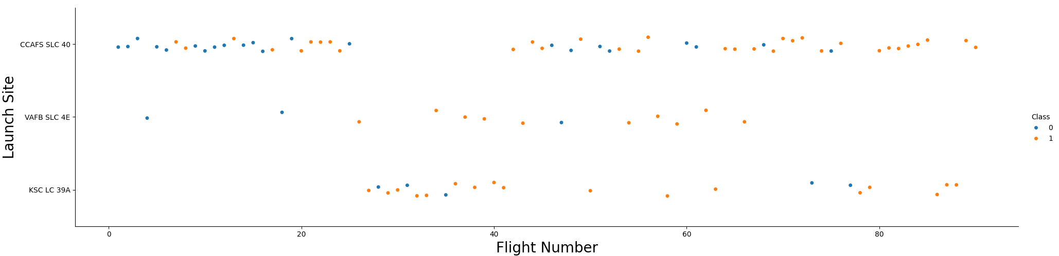
Flight Number vs. Launch Site
The success rate of number of flights at site CCAFS SLC 40 is mostly evenly distributed.
VAFB SLC 4E has a higher success rate spread fairly across the number of flights
KSC LC 39A’s flights also display a higher success rate with more flight numbers which is reassuring.

Slide 19
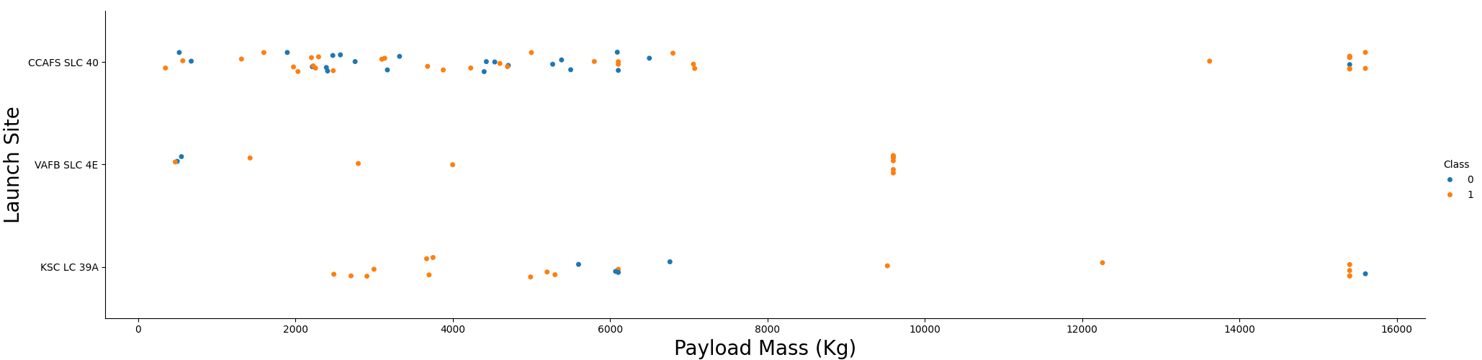
Payload vs. Launch Site
There are no rocket launches with payloads above 10000 Kg at VAFB SLC 4E.
Success rates for CCAFS SLC 40 cannot be accurately predicted for payloads less than 8000 kg. Although for payloads above 15000 Kg, the success rate is high.
At KSC LC 39A, it can be confidently concluded that for payloads below 6000, the success rate is high.

Slide 20
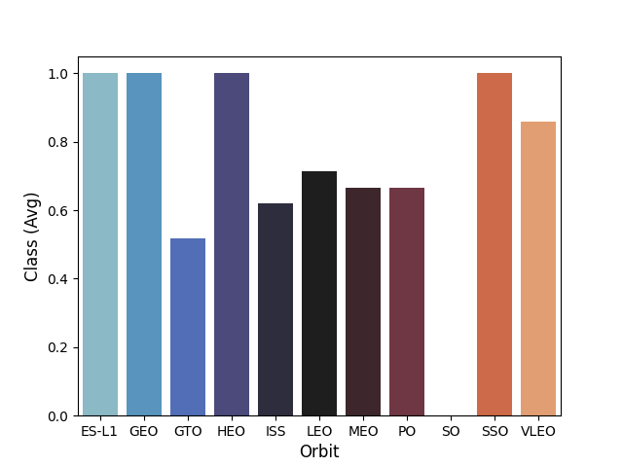
Success Rate vs. Orbit Type
The highest success rate lie within the orbits of ES-L1, GEO, HEO, SSO.
The absence of a bar at SO is because only 1 flight was launched at this orbit which resulted in a failure.

Slide 21
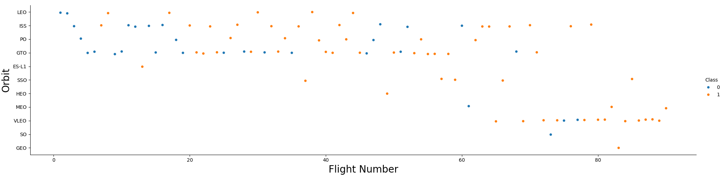
Flight Number vs. Orbit Type
In the LEO orbit, as the number of flights increase, so does the success rate.
For VLEO, no flight records exist below 60 flights. However, it showcases a high success rate.
With GTO, no success rate pattern can be discerned between the orbit and flight number.

Slide 22
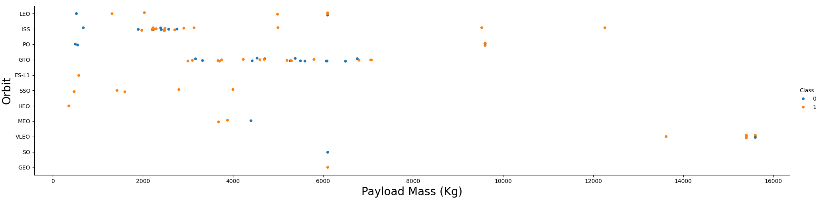
Payload vs. Orbit Type
At heavier payloads, the success rate is higher for orbits: LEO, ISS, PO and VLEO. However, VLEO has no launches with payloads below 15000Kg.
At GTO, a success rate accuracy cannot be predicted across all its payload records.

Slide 23
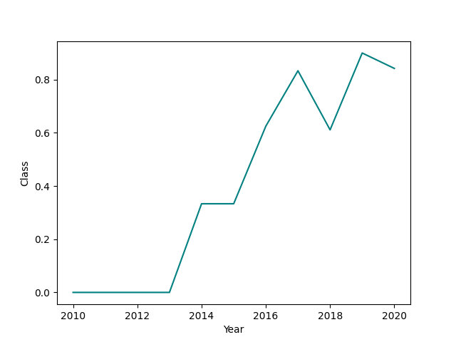
Launch Success Yearly Trend
The success rate has been climbing since 2013. It stabilized briefly in 2014 before climbing again till 2017.
There was a momentary decline towards the end of 2018 before climbing back higher than before till 2019. After which is starts to decline again.

Slide 24
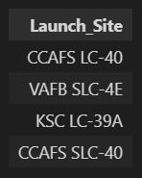
All Launch Site Names
These are the names of the launch sites used by SpaceX to launch payloads on their mission ready rockets to outer space.
The SQLite command extracted all the distinct names launch-site names from spacextable.

Slide 25
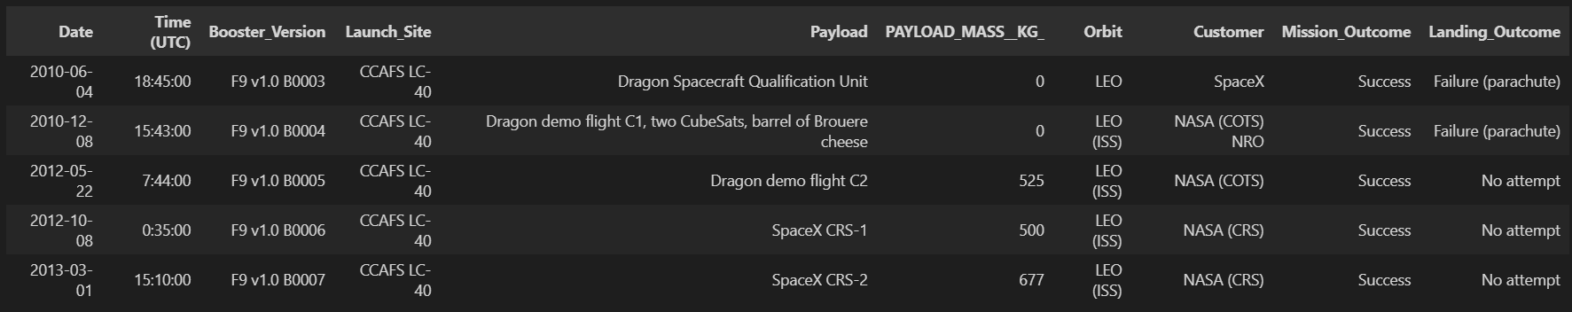
Launch Site Names Begin with 'CCA'
5 records of sites beginning with `CCA`. This includes only CCAFS LC-40 when limited to 5.

Slide 26
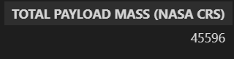
Total Payload Mass
The total payload mass of NASA equals 45596 Kg.

Slide 27
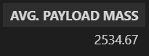
Average Payload Mass by F9 v1.1
The average payload mass carried to space by all the boosters of version F9v1.1 came upto approximately 2534.67 Kg

Slide 28
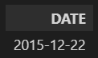
First Successful Ground Landing Date
The first successful landing outcome on ground pad was in 2015 on 22nd of December.
The sql filtered the table to extract the first date where the landing outcome was successful for ground pad launches.

Slide 29
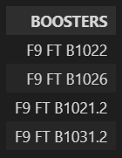
Successful Drone Ship Landing with Payload between 4000 and 6000
The names of boosters with successful landings on drone ship carrying a payload mass between 4000 & 6000 Kgs are presented in the image.
A subquery was first used to extract successful landings on drone ships which was then further queried to filter payload masses between 4000 and 6000 Kgs

Slide 30
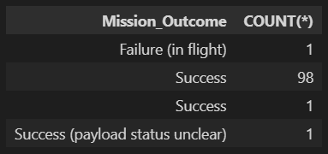
Total Number of Successful and Failure Mission Outcomes
There were 99 confirmed successful mission outcomes out of 101
There are 2 success categories. This is due to a formatting error in the record where one success record contains additional empty spaces.

Slide 31
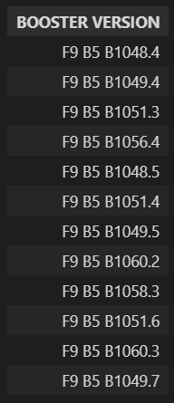
Boosters Carried Maximum Payload
These are all the boosters that carried the maximum payload mass.
These names were extracted from a subquery where the max payload mass was first extracted and then passed as a condition to determine all boosters that carried payloads equal to it.

Slide 32
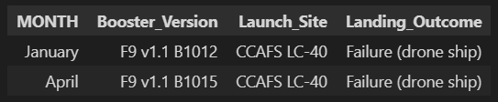
2015 Launch Records
These are the failed landing_outcomes on drone ships, the booster versions, and launch site names in 2015
A Case set was generated to get the month names from the sql which was then filtered for data on failed drone ships launches and the year 2015.

Slide 33
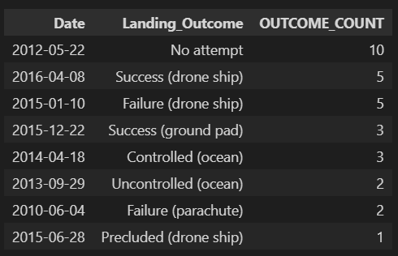
Rank Landing Outcomes Between 2010-06-04 and 2017-03-20
These are all the landing outcomes between the provided dates mentioned in descending order.
‘No attempts’ scored the highest count with 10 records. Meanwhile, only 1 record of ‘Precluded (drone ship)’ exists.

Slide 34

Section 3

Slide 35
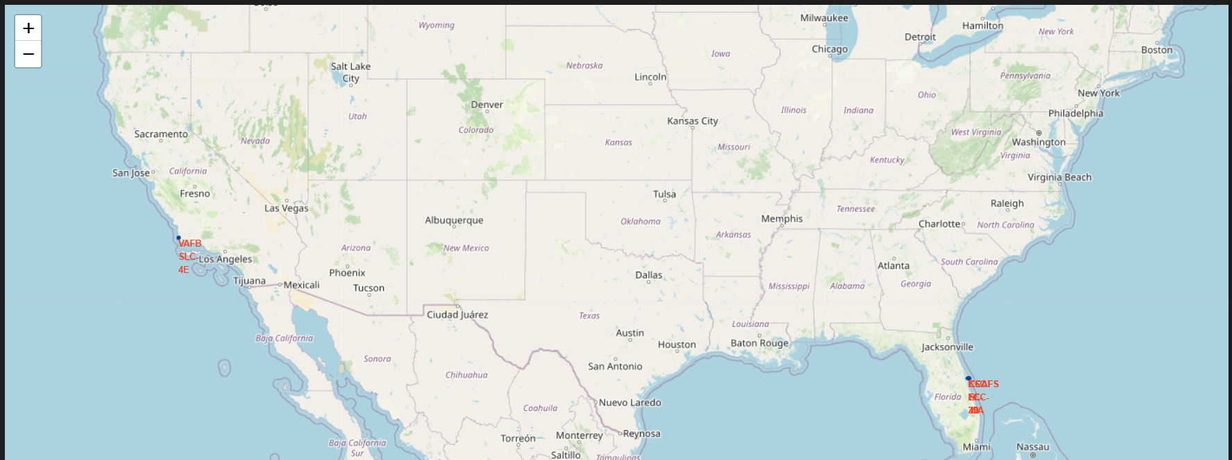
Map of all Launch Site Coordinates
SpaceX has 4 launch sites. 1 (VAFB SLC-4E) is in California while the other 3 (CCAFS LC-40, CCAFS SLC-40 and KSC LC-39A) are situated in Florida.

Slide 36
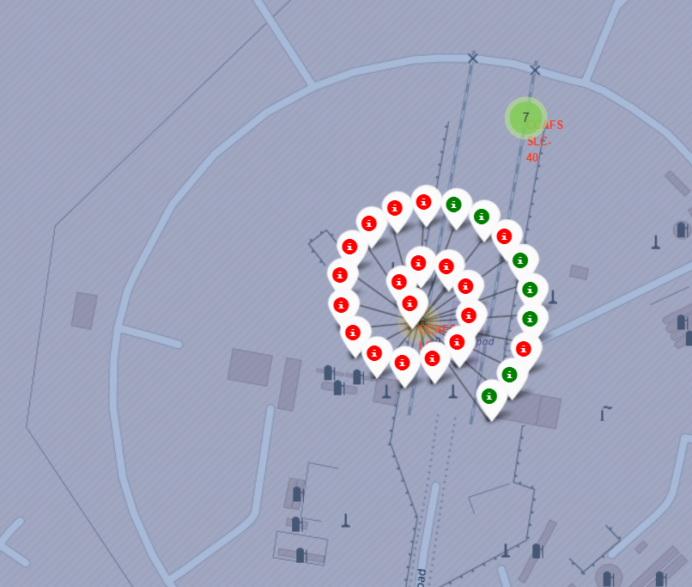
Map of Launch Outcomes on site CCAFS LC-40
There were 26 launches from this site out of which, only 7 were successful showcasing a success rate of 26.92%

Slide 37
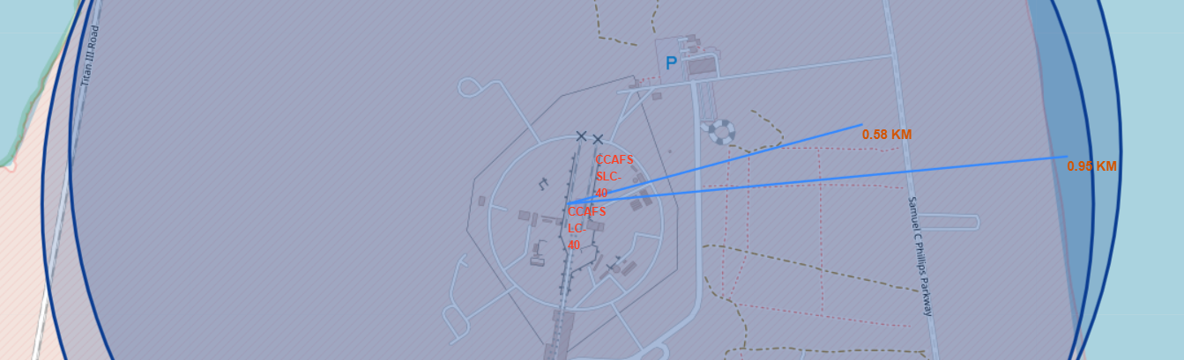
Map of Nearby Landmarks to Lauch Site CCAFS LC-40
Here you can see the distance between the launch site and 2 landmarks (Highway and Coastline) marked with blue lines and labelled.

Slide 38

Section 4

Slide 39
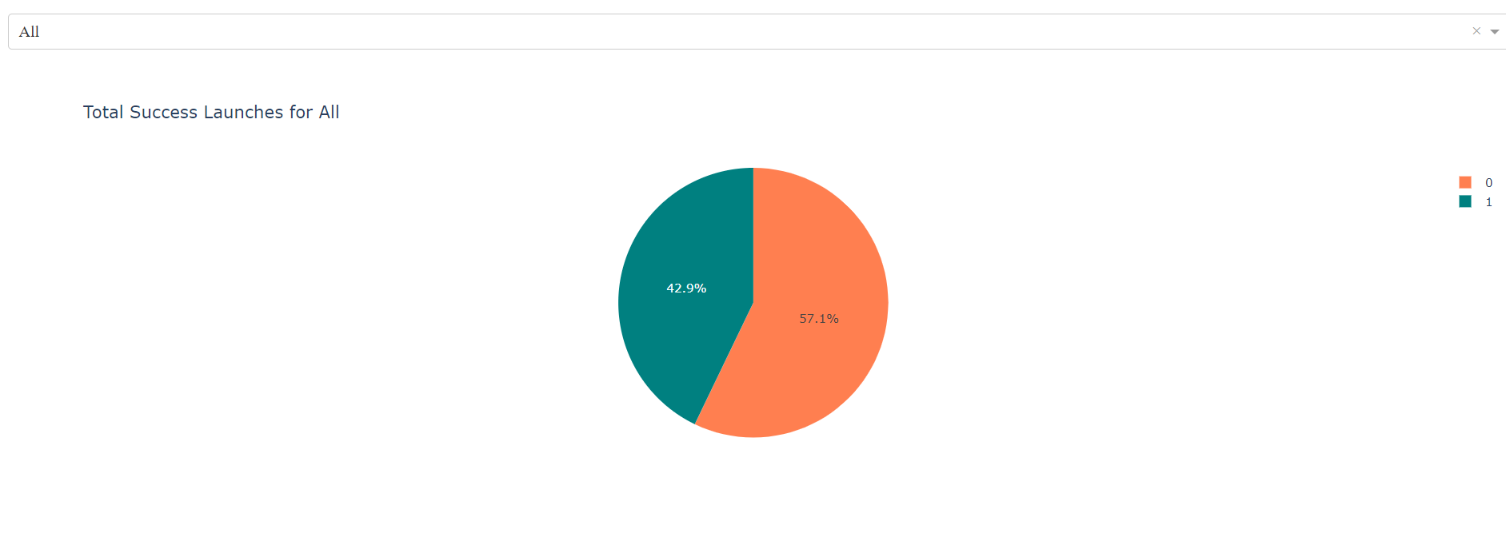
Dashboard: Success Outcome Count of All Sites
The statistics reveal an overall success rate of under 50% suggesting that there is room for improvement.

Slide 40
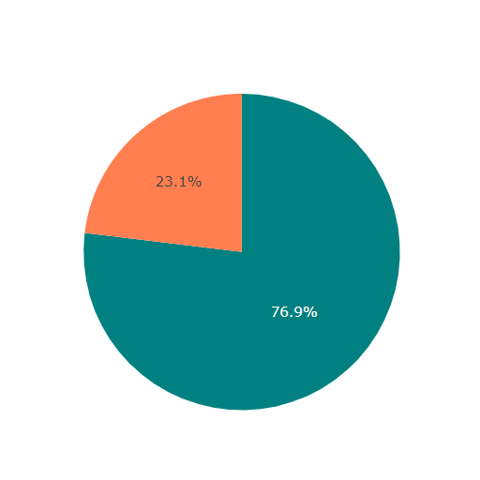
Dashboard: Highest Success Ratio Site
The highest launch success ratio is at site: KSC LC-39A
The success rate at this site is greater than ¾ of the total launch outcomes. CCAFS SLC-40 comes at second place with a success rate of 42.9% followed by VAFB SLC-4E (40%) & CCAFS SLC-40 (26.9%)

Slide 41
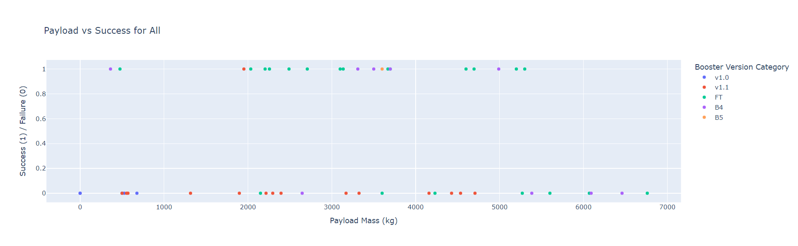
Dashboard: Payload vs Launch Outcome Scatter Plot
Payload vs Success outcome statistics for 5 booster versions.
The highest success rate is seen by booster version ‘FT’ meanwhile the one with the lowest success rate is ‘v1.1’
There are more overall failed launch outcomes than successful ones suggesting some room for improvement.
‘FT’ & ‘B4’ are the only boosters capable of successfully carrying payloads more than 4500 Kgs

Slide 42

Section 5

Slide 43
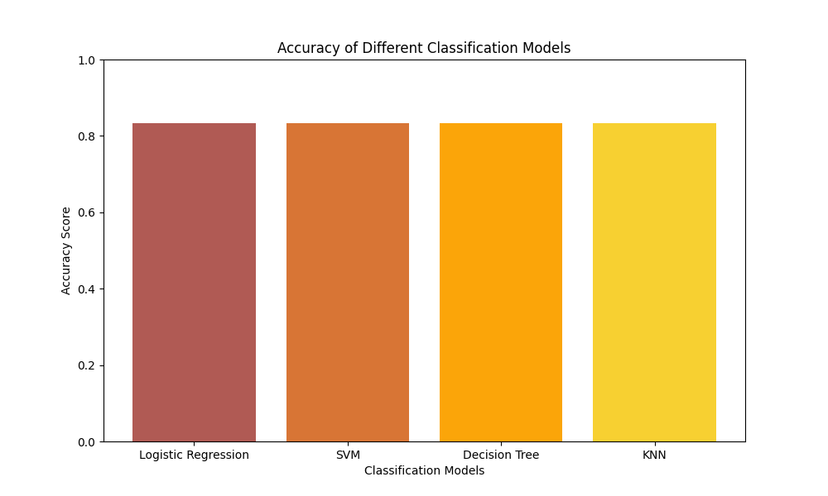
Classification Accuracy
All the models perform the same with an accuracy of 0.833334
In this case, the model should be chosen based on complexity, training time, etc. Recommendation is to use KNN since it is much simpler to implement and won't be slow as it isn't working with a large dataset.

Slide 44

Confusion Matrix
KNN confusion matrix.
It accurately predicted the ‘landed’ cases and only misrepresented 3/6 ‘did not land’ cases and ‘landed’.

Slide 45
Conclusions
Orbits with the highest average success rates are ES-L1, GEO, HEO, SSO.
The F9 booster versions capable of successfully carrying the heaviest payload masses (> 4500 Kgs) are ‘FT’ and ‘B4’
Launch Site ‘KSC LC-39A’ is the best performing launch site with a nearly 75% launch success rate.
Stick to using the KNN classification model as it is less computationally intensive given the dataset we are working with.

Slide 46


